Slide 1


Business Analysis
1

Slide 2

Telecom Customer Churn Analysis
Group II
David LOUIS
Yvesna MARCELIN
Wedsanley JEAN PHILIPPE
Kesnel Samuel JEAN PHILIPPE

Slide 3
Agenda
Introduction - Client, Problem
Systems Analysis of Problem - Review stakeholders, deﬁne measurements of performance
Relevant Analytics - Analysis
Alternative Solutions - Explanation of solutions, comparison of outcomes
Recommendations - What should the client do next? What is the recommended next step?
Appendix - Additional Resources

Slide 4
Introduction
CHURN ANALYSIS
Churn analysis is the process of using data to understand why customers have stopped using products or services of a company during a given time period. It’s about figuring out why customers are churning at the rate they are, and how to fix the problem.
The customer churn analysis helps the company to retain its customers and ensure that the services offered satisfy its customers’s base.

Slide 5
Systems Analysis
The client is a telecommunications company that has dominated the telecommunications market for years.
Although the company is a leader in the telecommunications market, many of its customers are leaving it for its growing competitor and, due to market saturation, new customers are becoming scarce. The company must therefore find a way to keep its customers at all costs. To do this, the company must be able to identify the characteristics of the customers who have left and know what services are driving them away or what would have attracted them to the competitor.

Slide 6
Stakeholders
The Company
The company is most affected by this problem because it loses its reputation and customers, which significantly reduces its revenue.
And by losing both, it risks bankruptcy.
The Competitor
The competitor is positively affected by the problem because it gains more market share due to customer churn

Slide 7
Methodology
The company shared with us a dataset with 7,043 customers. It contains information about customer’s demographics data , the services that they’re using and indicates whether a customer has been churned or not.
Python libraries were used to perform the data processing as well as the statistical analysis needed to draw insights.
As a statistical chi-square test was used to check the dependence of the different categorical variables on the target variable, then Cramer's V was used to check the level of dependence of these variables and python libraries like Matplotlib Pandas and Seaborn have been used to visualize the data.
These tests are necessary to determine the profile of customers who churn.

Slide 8
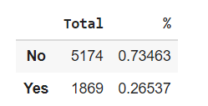
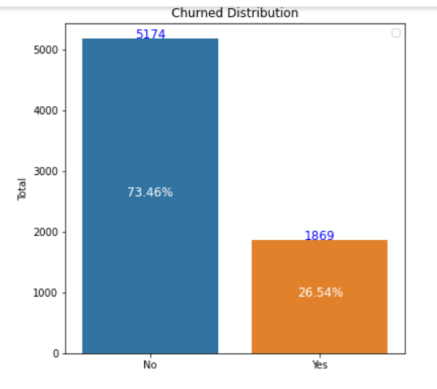
Churned Rate
Compared to the existing customer
base the churned customer represent
26.54 % of the population
Total number of customers who
churned is 1869 while the number of
remaining customer 5174 which
represent 73.5% of the population.

Slide 9
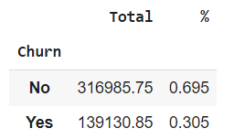
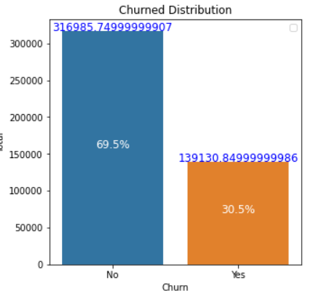
Churn Amount
The company's revenue for the month is $316 985.75, the losses caused by unsubscribed customers is $139 130.58 which represents 30% of the total amount.

Slide 10
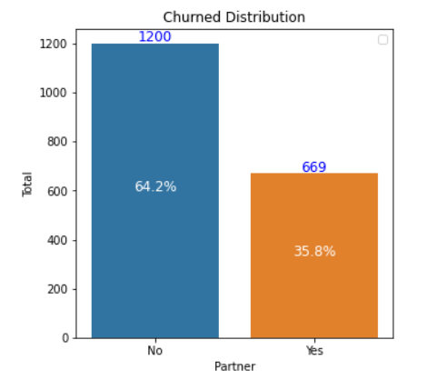
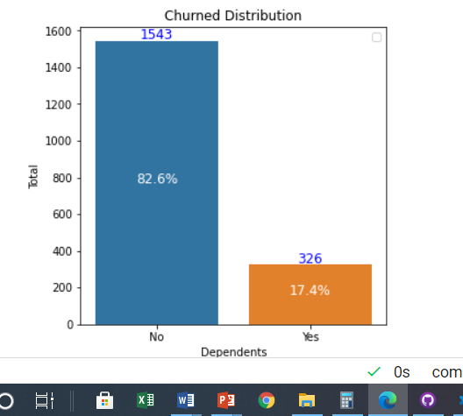
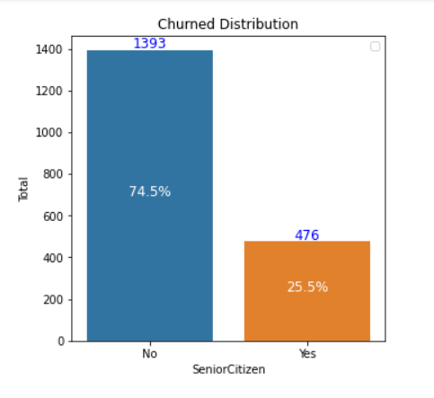
Demographic variable vs Churn
Statistical tests(chi-square/ Cramer’s V) show that the level of churn depends on these three demographic variables.
64.2% of the churned customer doesn’t have a partner.
82.6% of churned customer doesn’t have a dependents.
74.5% of churned customer are young.

Slide 11
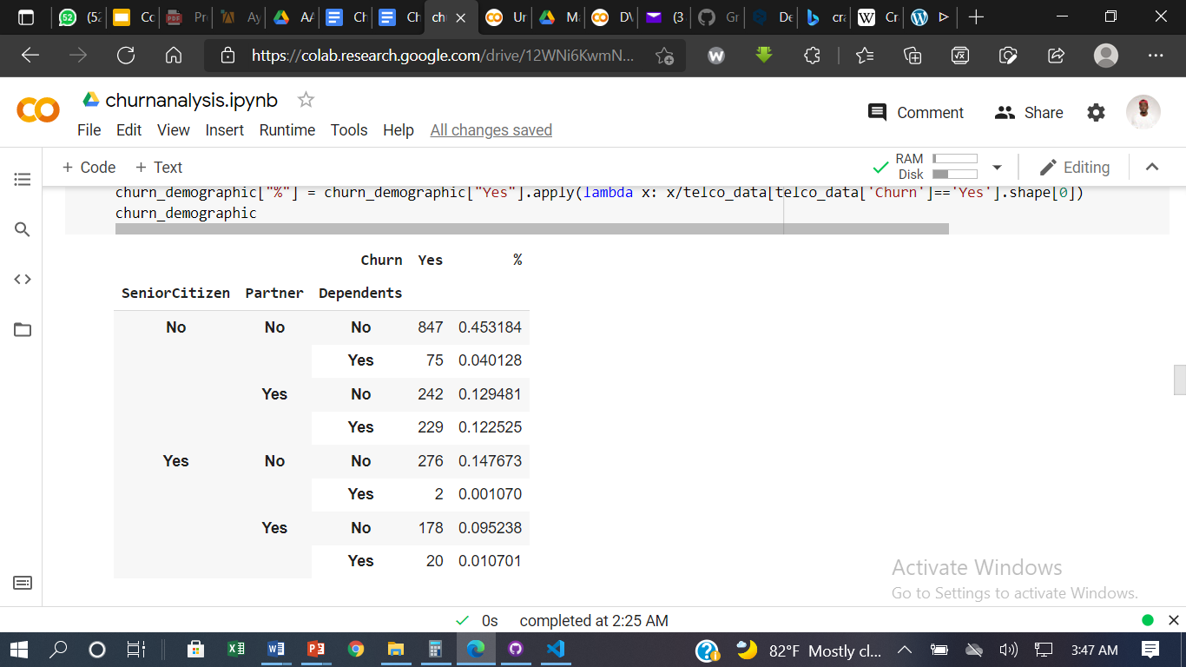
Demographical variable vs Churn
Young Clients with Single Status and No Dependents represent 45.31% of the churned customer with a total of 847.
In terms of demographic variables, the most obvious profile of churned customers is that of a young single person without dependents.

Slide 12
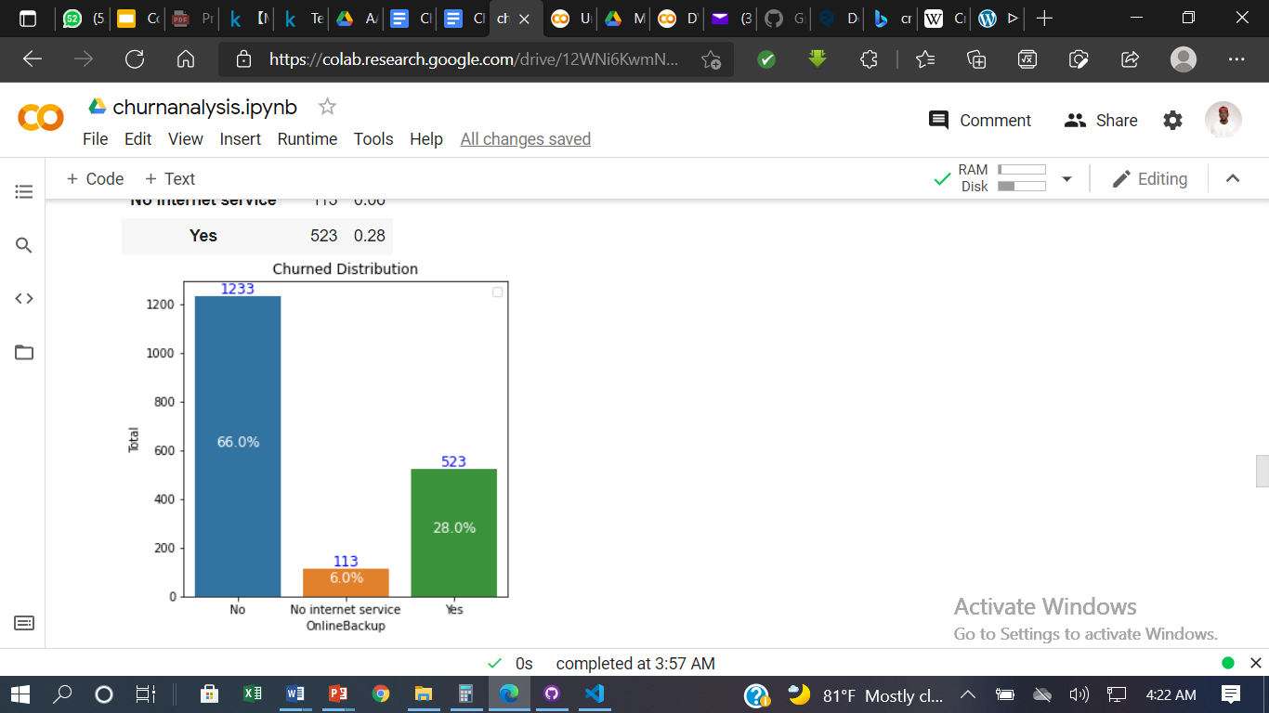
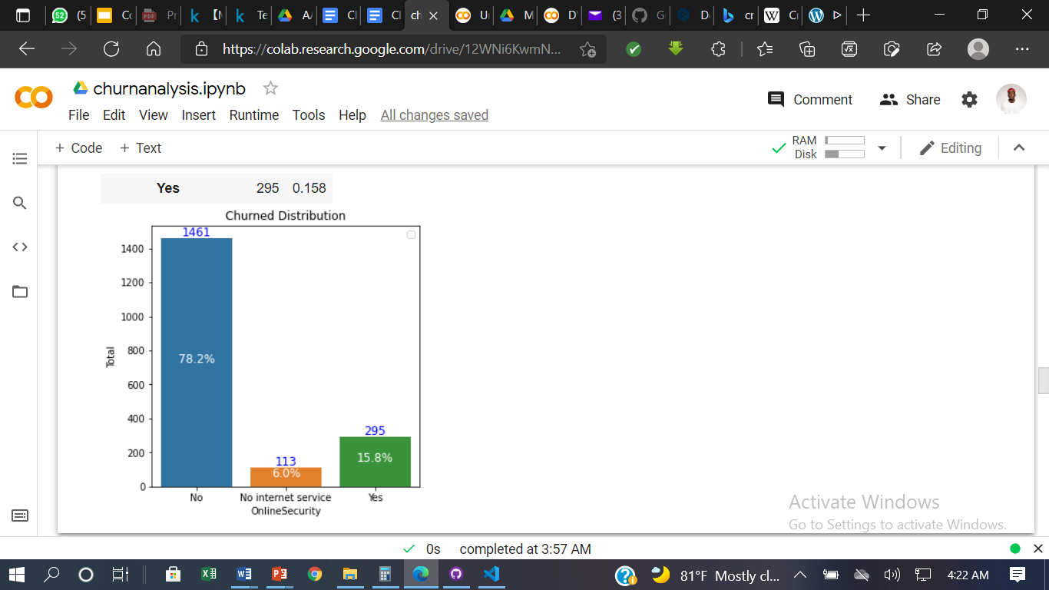
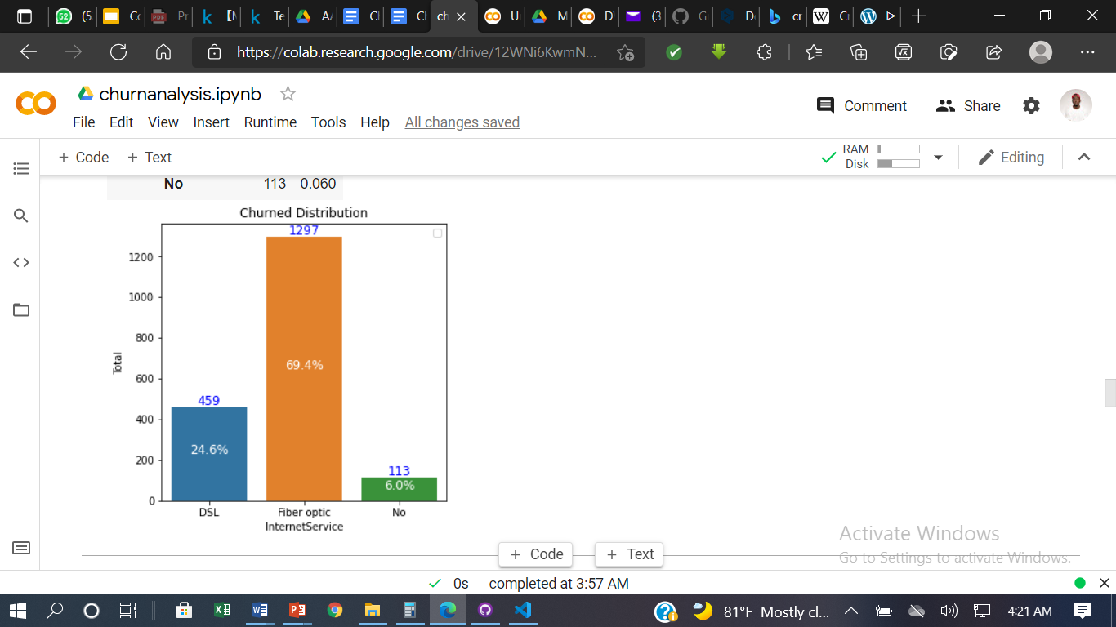
Services Used vs Churn
Statistical tests(chi-square/ Cramer’s V) show that the level of churn depends on these variables.
66% of the churned customer doesn’t use OnlineBackup.
78.2% of churned customer doesn’t use OnlineSecurity.
69.4% of churned customer used InterService specially Fiber Optic.

Slide 13
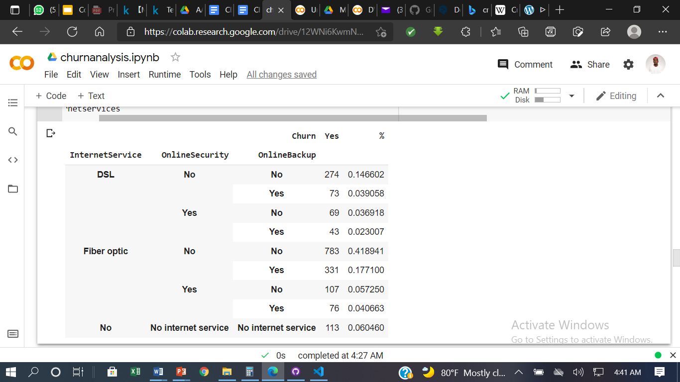
Services Used vs Churned
Customers who use Internet Service specially Fiber Optic with
no OnlineSecurity
and
no OnlineBackup
represent 41.89% of the churned customer with a total of 783.
In terms of Services Used, the most obvious profile of churned customers use Fiber Optic whithout using OnlineService or OnlineBackup.

Slide 14
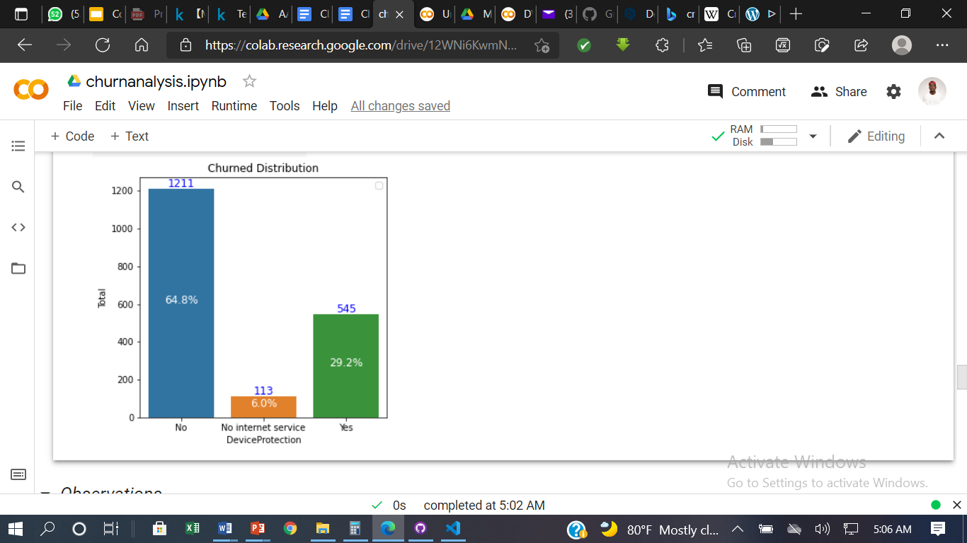
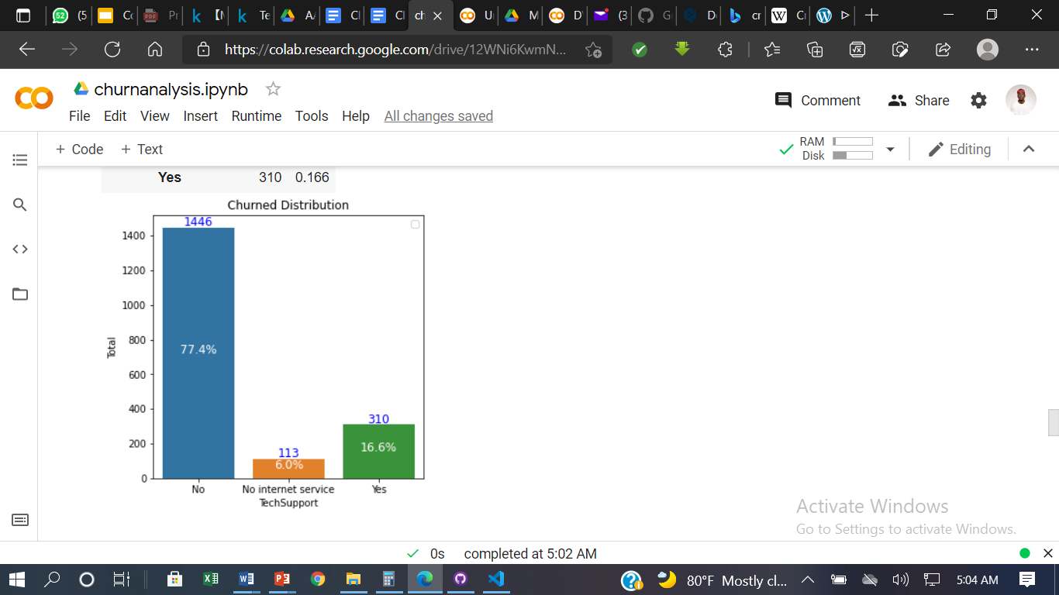
Services Used vs Churn
Statistical tests(chi-square/ Cramer’s V) show that the level of churn depends on these variables.
64.8% of the churned customer doesn’t use DeviceProtection.
77.4% of churned customer doesn’t use TechSupport.

Slide 15
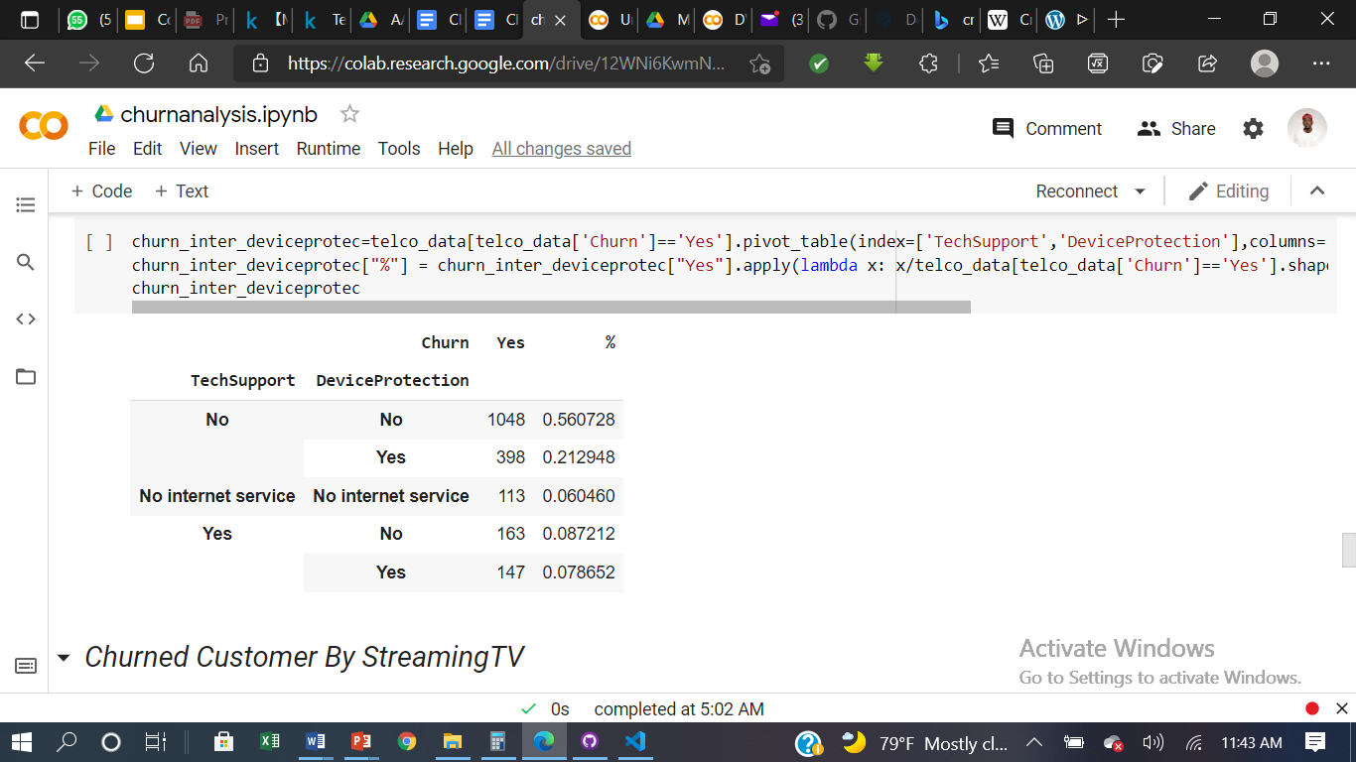
Services Used vs Churned
Customers who don’t use
TechSupport
and
DeviceProtection
represent 56.07% of the churned customer with a total of 1048.
In terms of Services Used, the most obvious profile of churned customers don’t use TechSupport or DeviceProtection.

Slide 16
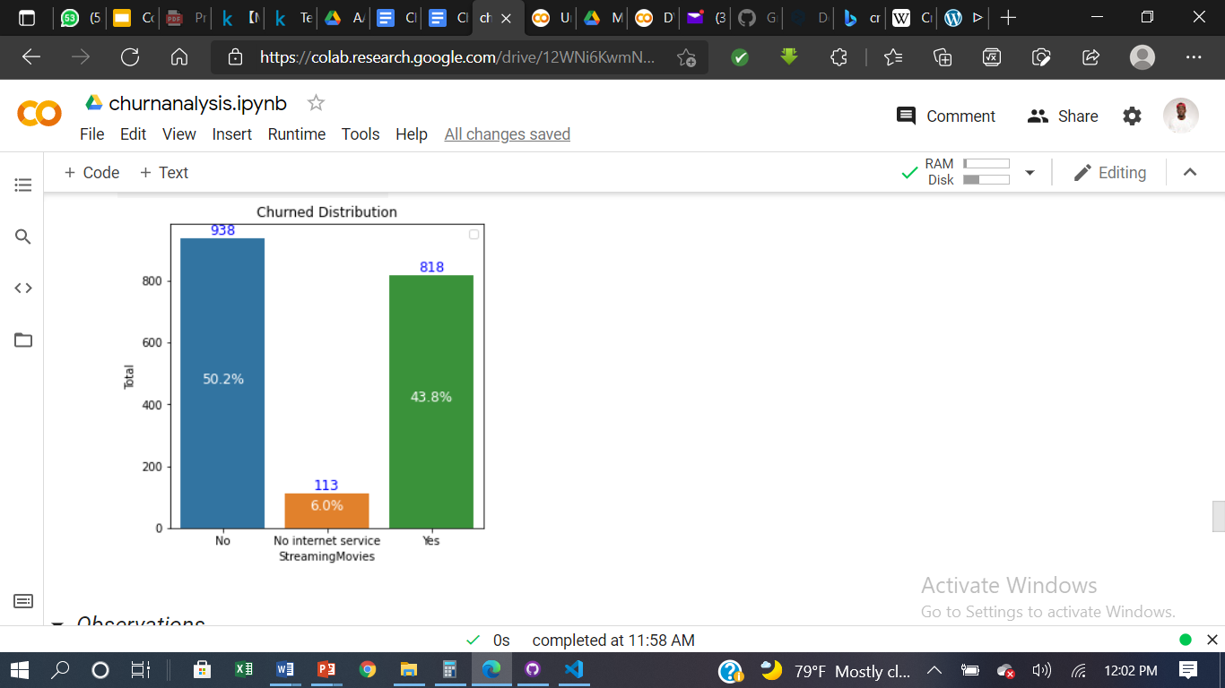
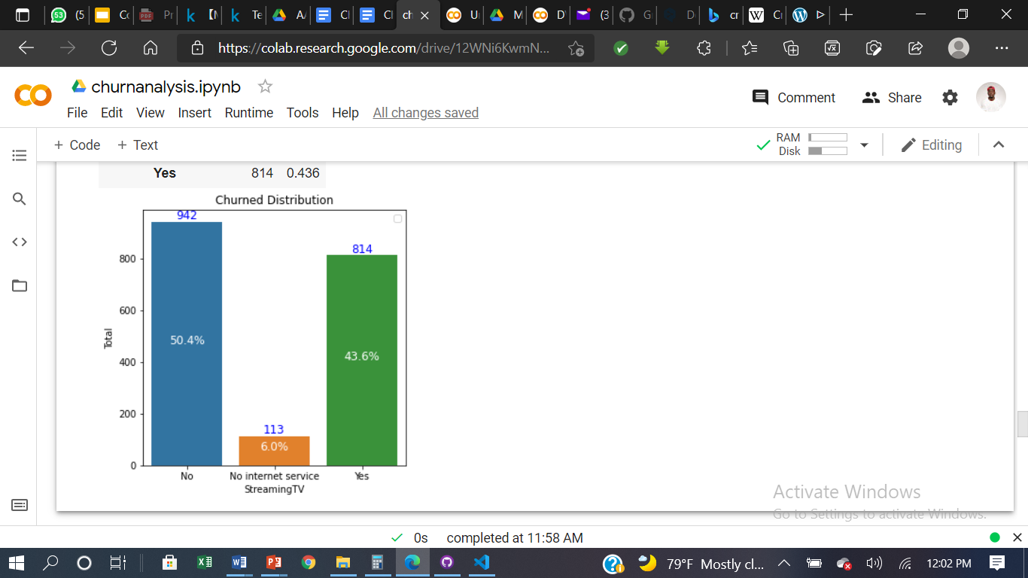
Services Used vs Churn
Statistical tests(chi-square/ Cramer’s V) show that the level of churn depends on these variables.
50.2% of the churned customer doesn’t use StreamingMovies.
50.4% of churned customer doesn’t use StreamingTV.

Slide 17
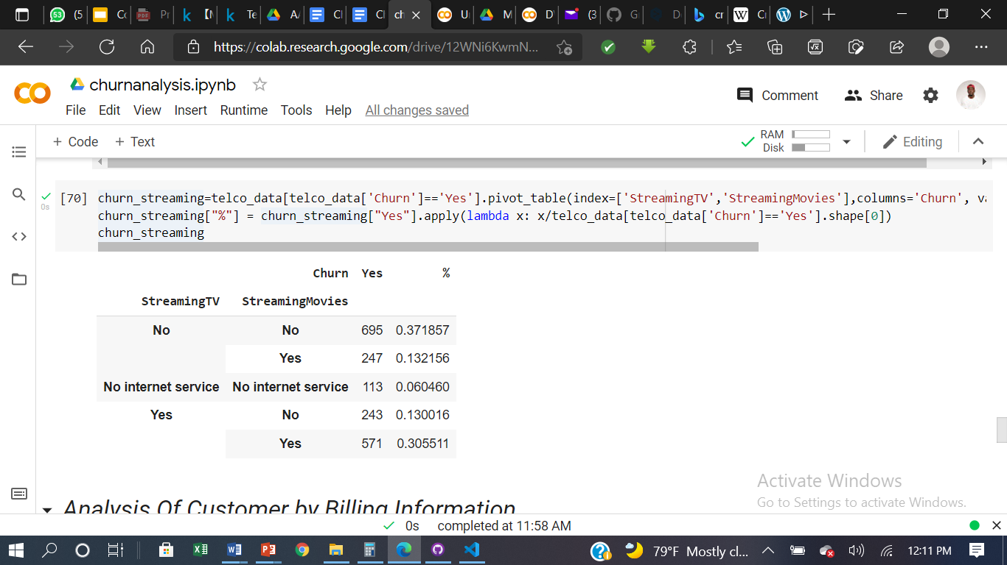
Services Used vs Churn
Customers who don’t use
StreamingTV
and
StreamingMovies
represent 37.18% of the churned customer with a total of 695.
In terms of Services Used, the most obvious profile of churned customers don’t use StreamingTV or StreamingMovies.

Slide 18
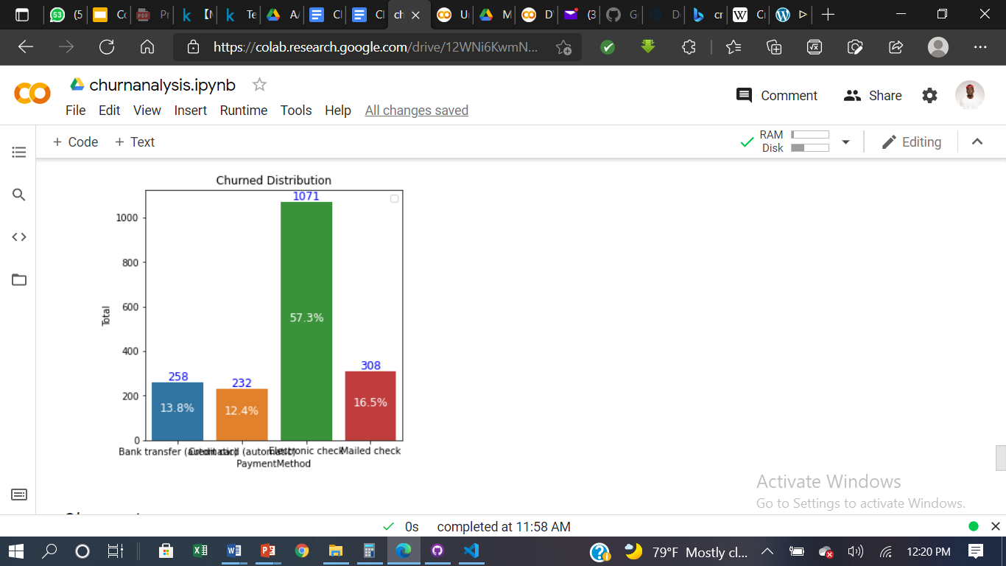
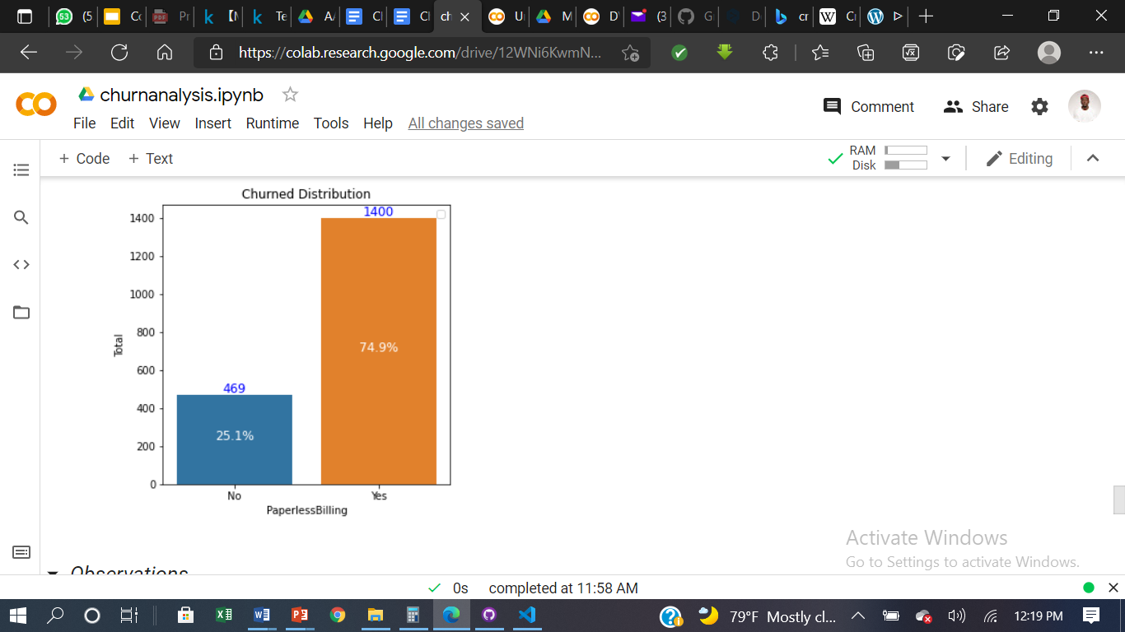
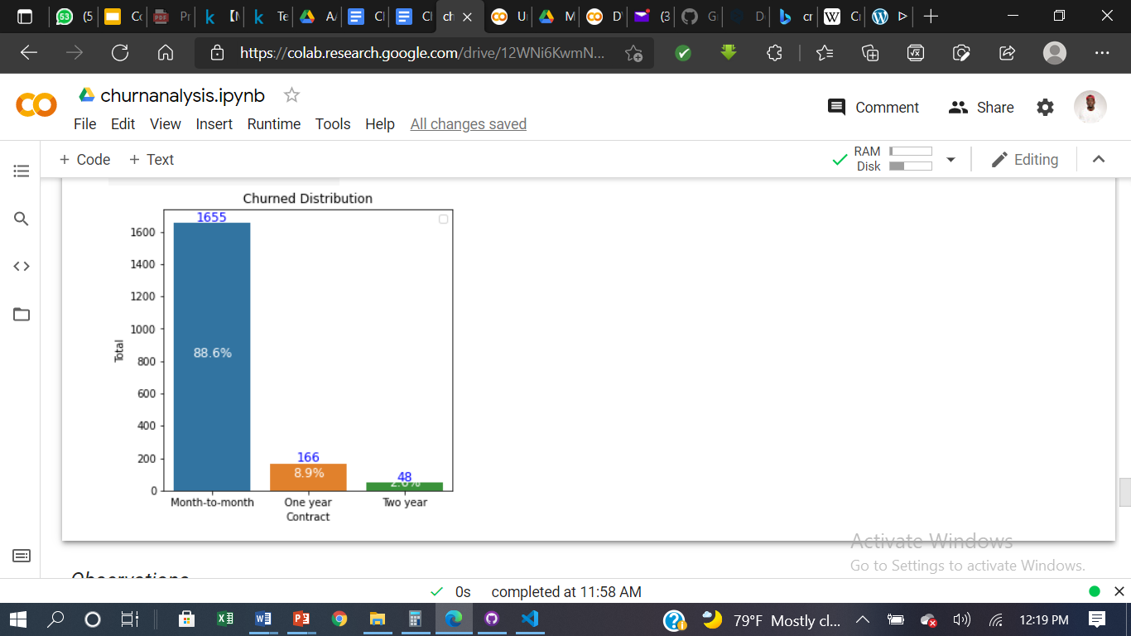
Billing Information vs Churn
Statistical tests(chi-square/ Cramer’s V) show that the level of churn depends on these variables.
57.3% of churned customer use Electronic Check as Payment Method.
74.9% of churned customer use PaperlessBilling
88.6% of churned customer use Month-to-Month Contract
.

Slide 19
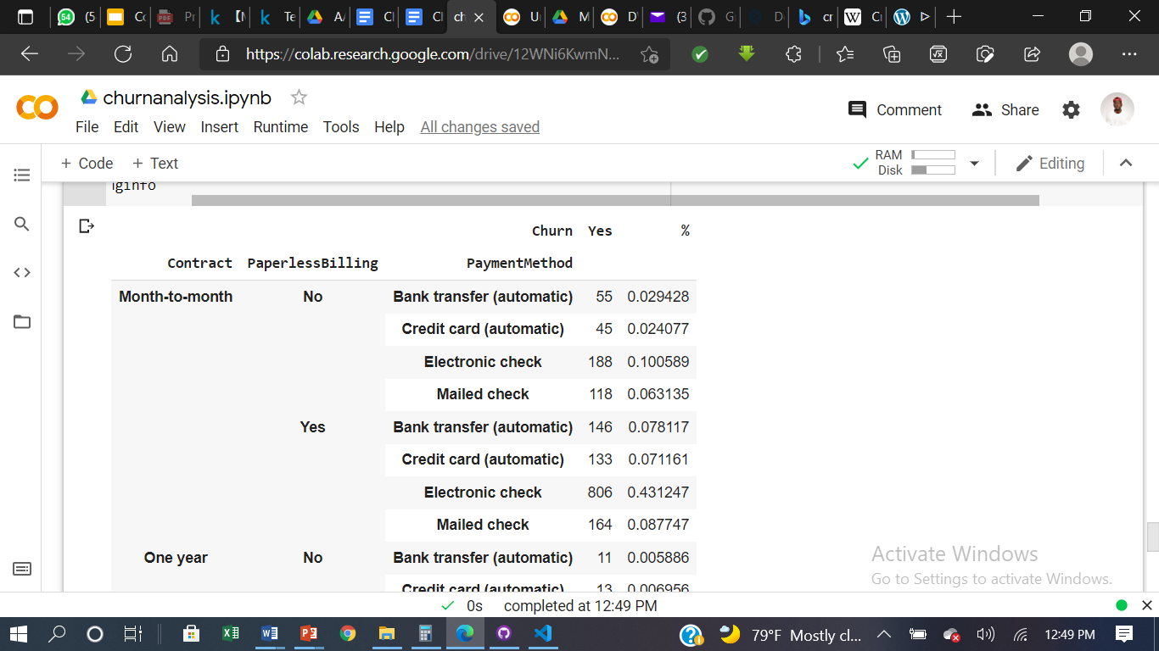
Billing Information vs Churn
Customers who use
Month-to-Month Contract,
PaperlessBilling and
Electronic Check as PaymentMethod
represent 43.12% of the churned customer with a total of 806.
In terms of Billing Information, the most obvious profile of churned customers with Month-to-Month Contract,PaperlessBilling and Electronic Check as Payment Method.

Slide 20
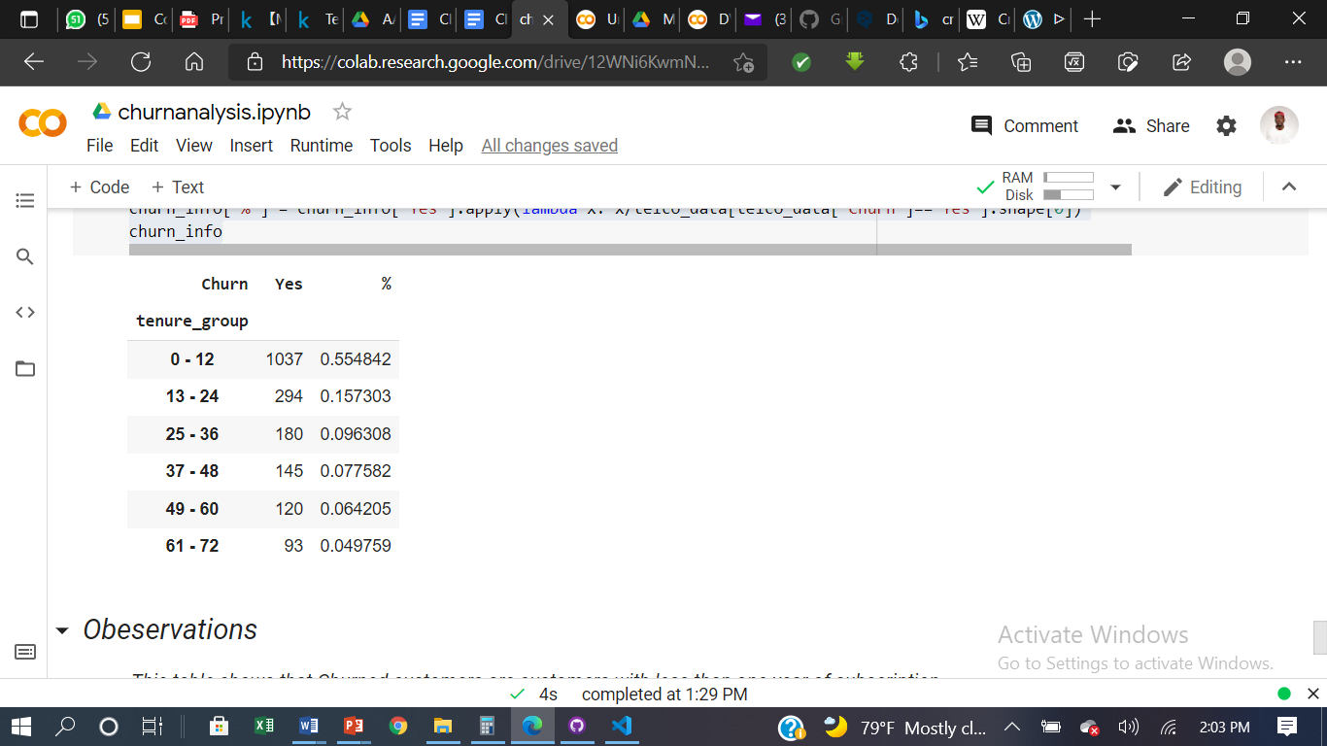
Tenure vs Churn
This table shows that unsubscribed customers are customers with less than one year of subscription.
In terms of time of subscription, churned customers are new customers with less than one year of subcription

Slide 21
Summary of Churned Customer Profile
The Profil of Churned Customer is a
Non SeniorCitizen with
No Partner with
No Dependents
who uses the Fiber Optic option as an Internet Service,
does not use
DeviceProtection ,TechSupport ,OnlineBackup,OnlineSecurity,StreamingTV or StreamingMovies,
use
Month-to-Month Contract with PaperlessBilling with Electronic Check as Payment Method

Slide 22
Potentiel Solution
Get Churned Customer’s Feedback
Get Current Customer’s Feedback
This way, the company can show that it really cares about the situation, and it will instantly find out what went wrong.
This way, the company will know what its customers like or dislike about its services and will have time to anticipate before customers decide to Churn..
Improve the Fiber Optic Line
Fiber Optic Customers are churning at an alarming rate.
Fiber customers represent 69.39% of the churned population , improving this line will significantly reduce the churn rate.

Slide 23
Potential Solutions
What is the current state?
What are the options the client can pursue?
Ideally try to put them on one slide for easier comparison, you can have separate slides to go into detail
Option 1:
- Profit Margin: 7%
Option 2:
- Profit Margin: 18%
Option 3:
- Profit Margin: 35%

Slide 24
Recommendations
What are you recommending and why?
What are the next steps with your recommendation? How can the client make an impact and change?

Slide 25

Appendix & References
Dataset
Telecom Churn Customer Analysis Dataset
Project GitHub Link
Telecom Churn Analysis Project

Slide 26
Thank You!

